Slide 1


TRANSFORMING ADVERSARIAL SAMPLES INTO CLEAN SAMPLES
Presented by The Keermada Fan Club

Slide 2
TEAM MEMBERS
K Rithwin
Ayush Meena
Ritesh Baviskar
Piyush Patil
Aaditi Agrawal
Aditya Jagdale

Slide 3
PROBLEM
Deep learning models are vulnerable to adversarial attacks that fool classifiers with tiny, imperceptible changes. Existing defenses often fail to generalize across attack types or hurt clean image performance.
We have built a hybrid system that detects whether the input is adversarial or not and the purifies adversarial images using Denoising Autoencoders(DAEs) trained on FGSM, PGD, BIM(A&B) attacks, improving robustness without sacrificing accuracy.

Slide 4
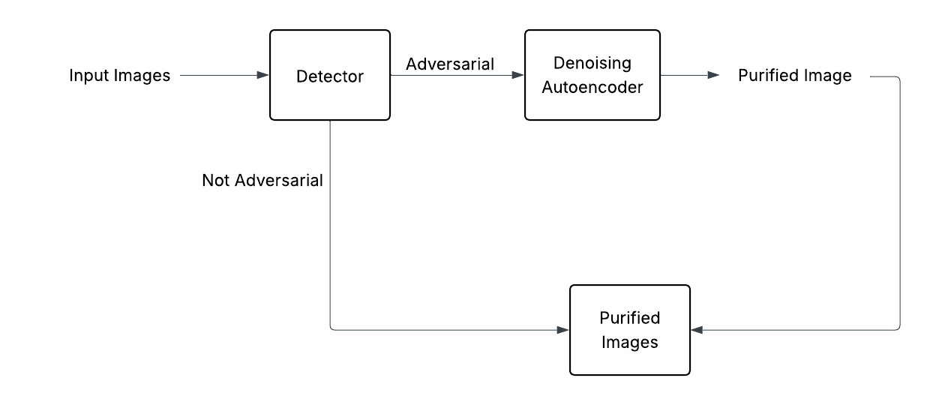
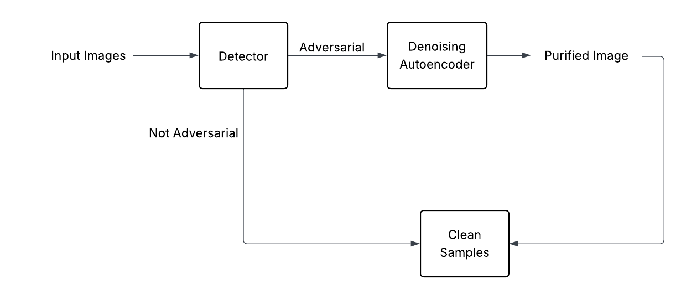
ARCHITECTURE

Slide 5
EXPERIMENT: DETECTION USING FEATURE SQUEEZING
Architecture Components:
1. Classification Model (DNN):
Pre-trained convolutional neural network (e.g., LeNet, CIFAR10 CNN).
Predicts labels for input samples (clean or adversarial).
2. Feature Squeezing Module:
Applies input transformation to reduce degrees of freedom.
Types of squeezing applied:
Bit Depth Reduction (e.g., 1-bit for MNIST, 5-bit for CIFAR).
Median Filtering (kernel size = 2).
Non-Local Means Denoising (for color images like CIFAR).
3. Distance-Based Detection:
Calculates the L1 distance between model predictions on original vs squeezed inputs.
The maximum distance across all squeezers is used as anomaly score.

Slide 6
Detection Process:
Training Phase:
Compute distances for clean validation samples.
Set a threshold based on a fixed False Positive Rate (FPR) (e.g., 5%).
Testing Phase:
Calculate distance for test (or adversarial) samples.
Predict as adversarial if the distance exceeds the threshold.

Slide 7
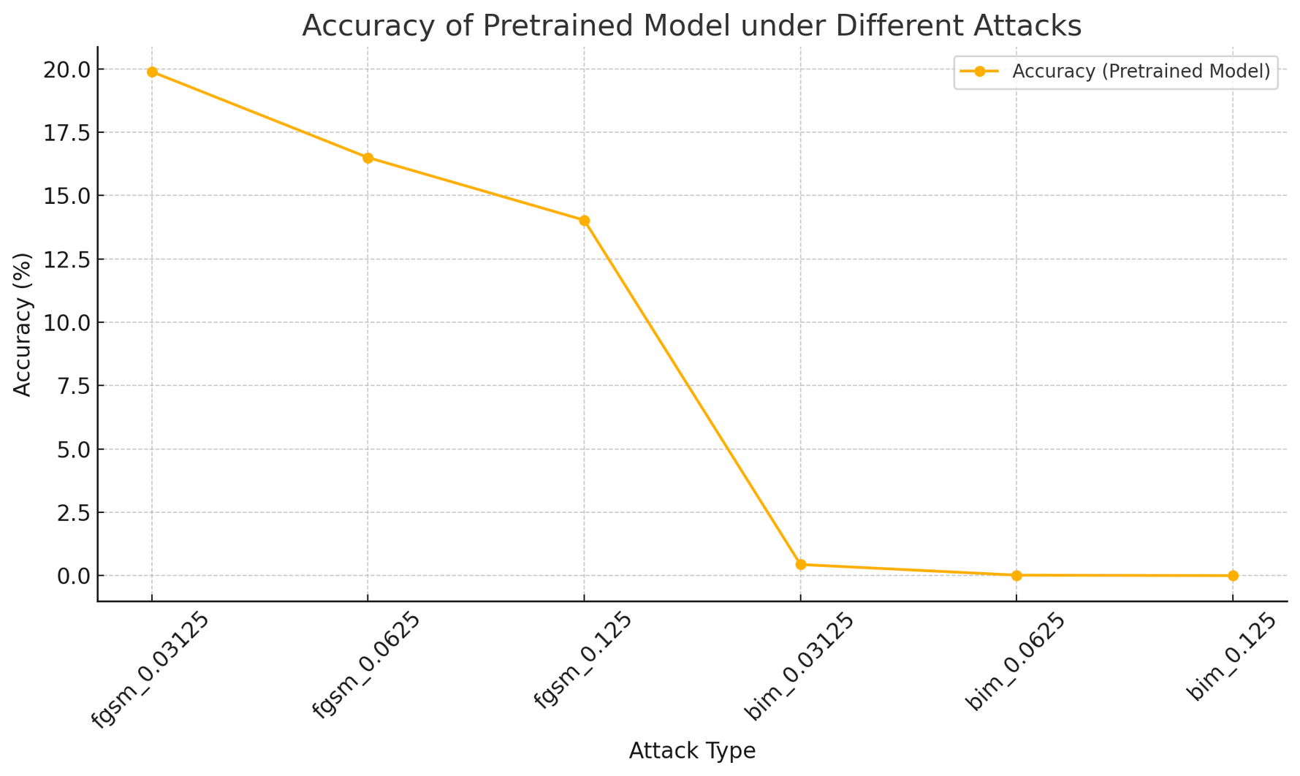

Slide 8
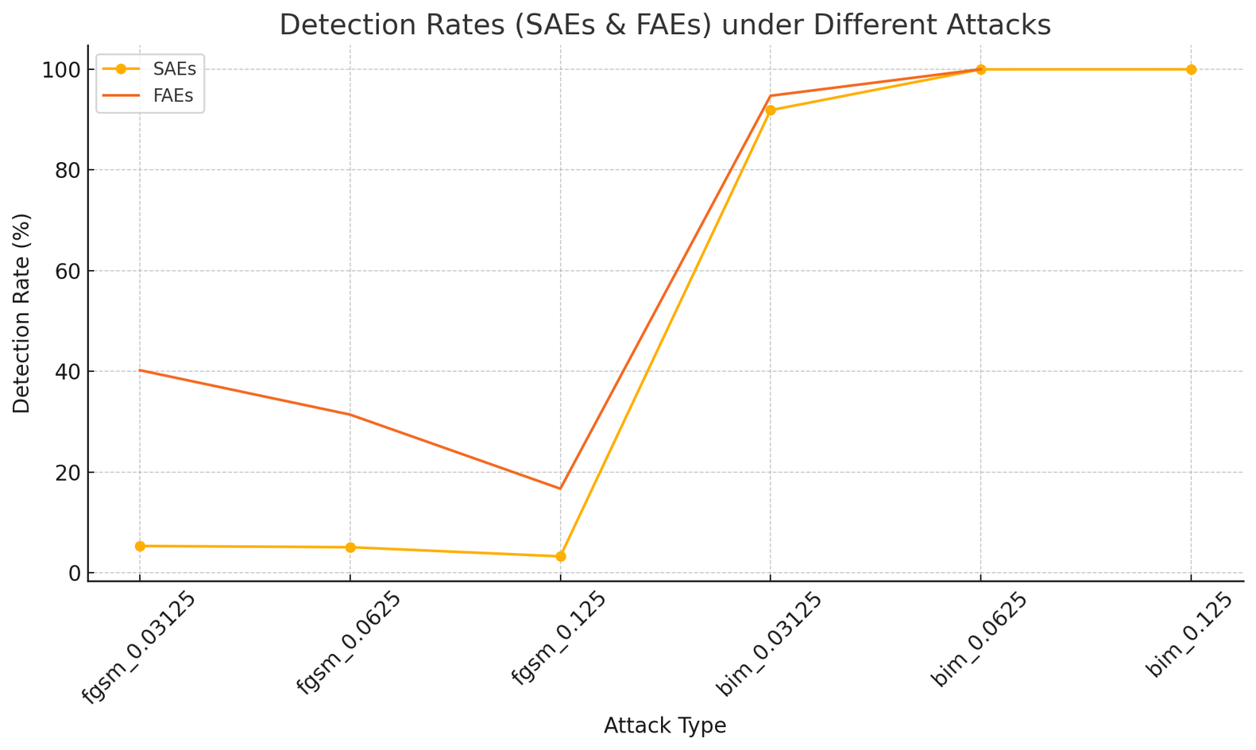

Slide 9
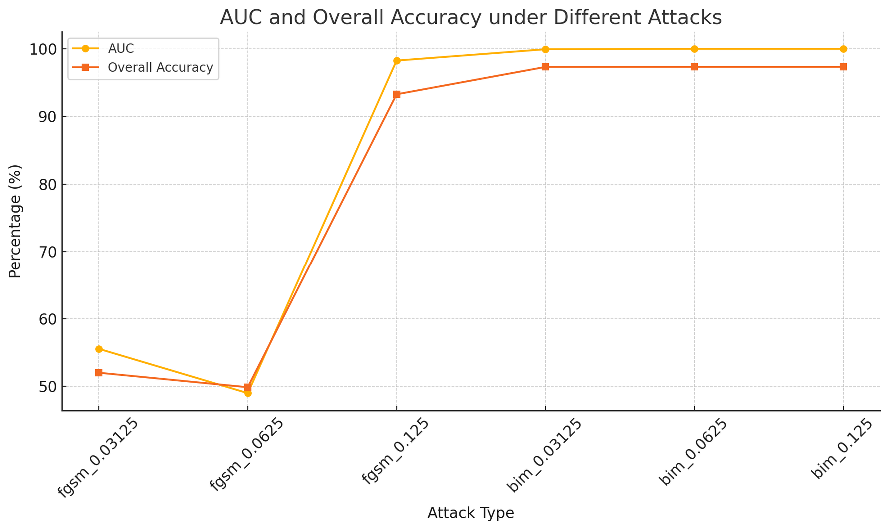

Slide 10
Why We Did Not Use the Feature Squeezing Model
Difficult to Integrate with Our Pipeline
Feature Squeezing requires preprocessing steps (e.g., reducing color bit depth or applying smoothing filters) that don’t align well with our existing data and model structure.
Incorporating these transformations would have required additional effort in tuning and validation for each attack scenario.
Not Suitable for General-Purpose Detection — Works Best for Specific Attacks (e.g., BIM)
Feature Squeezing is most effective against certain attacks like BIM, where perturbations are more noticeable and can be suppressed by reducing input complexity.
However, it tends to fail or give unreliable results against more advanced or subtle attacks like C&W or DeepFool, which are designed to bypass such defenses.

Slide 11

DETECTING ADVERSARIAL SAMPLES FROM ARTIFACTS
Architecture Components:
Feature Extraction Module (DNN):
Utilizes an architecture such as LeNet (or another convnet) to extract deep features.
Features are taken from the last hidden layer of the network.
Density Estimation:
Performs kernel density estimation in the space of the last hidden layer.
Key formulae:(kσ is the Gaussian kernel with tuned bandwidth).

Slide 12
Bayesian Uncertainty Estimates:
Achieved by using dropout at test time to compute Monte Carlo estimates of uncertainty.
Uncertainty is measured as the variance over T stochastic forward passes.
Combined Logistic Regression Detector:
Uses both density and uncertainty features as inputs.
The threshold-based classifier distinguishes adversarial samples from normal and noisy inputs.
ROC-AUC Score:
ROC (Receiver Operating Characteristic) is a curve showing how well a binary classifier (e.g., adversarial detector) separates two classes .
AUC (Area Under the ROC Curve) quantifies this performance as a single number between 0.5 (random guessing) and 1.0 (perfect detection).

Slide 13
IMPROVEMENTS IN ADVERSARIAL DETECTION
Baseline: KDE-Based Detection
Uses Kernel Density Estimation (KDE) on deep features to model per-class distributions.
Scores based on density + uncertainty.
Limitation: KDE can be sensitive to bandwidth and doesn't adapt well to adversarial shifts.
Improved: Dual Manifold Distance Detection
Introduced Dual Manifold Distance:
Models two separate feature manifolds: Clean and Adversarial.
Uses Mahalanobis distance to both manifolds for scoring.
Leverages discriminative gap between clean and adversarial spaces.
Still uses MC dropout uncertainty, combined with distance-based scores.

Slide 14
DETECTING ADVERSARIAL EXAMPLES USING DATA MANIFOLDS
Component | Description
Input Sample | Image given to both classifier and detector.
Feature Extraction | Use raw input or model’s internal features (like logits).
Manifold Learner | Uses training data to learn data manifold by techniques like LLE.
Distance Estimator | Computes distance of new input from the learned manifold.
Thresholding Logic | If distance is above a limit, it flags the sample as adversarial.

Slide 15
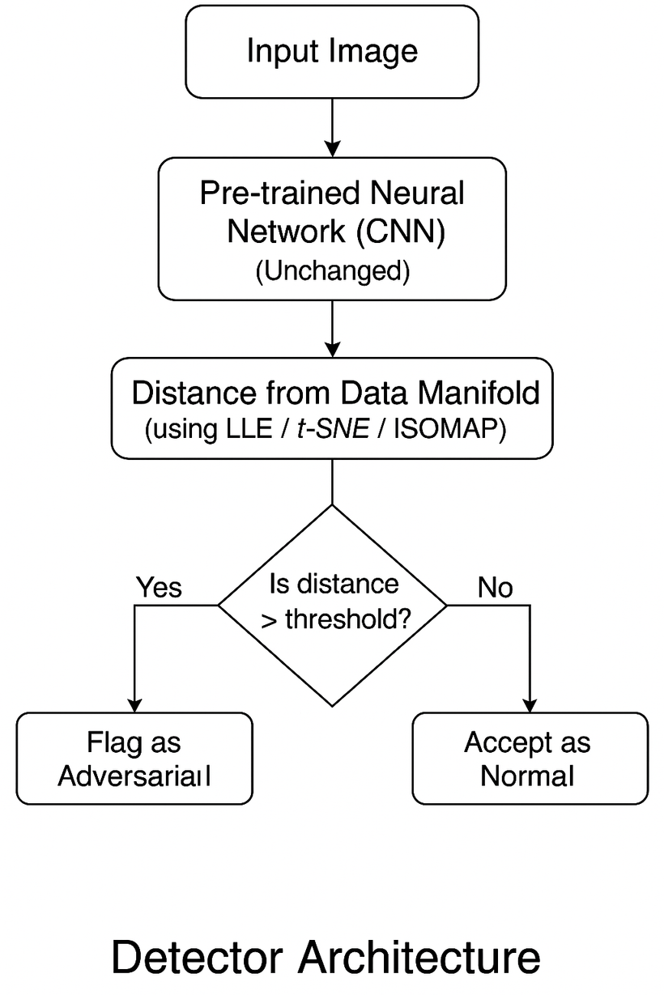
DETECTOR WORKFLOW
Step 1: Capture the true structure of clean training data using techniques like LLE, t-SNE, or ISOMAP
This reveals the underlying manifold of genuine data.
Step 2: Map test inputs into the same reduced space.
Step 3: Measure how far each input lies from the manifold.
Step 4: Apply a threshold-based decision to identify adversarial examples.

Slide 16
EXPERIMENTAL RESULTS & EVALUATION
Datasets Used: MNIST, cifar10
Adversarial Attacks Evaluated:
FGSM, BIM (with both BIM-A and BIM-B variants), and PGD.
Observations:
Density estimates decrease for adversarial examples.
Uncertainty values are higher for adversarial examples compared to normal samples.
The Dual Manifold approach effectively differentiates adversarial samples from normal and noisy images.

Slide 17
DETECTOR ROC-AUC SCORE FOR MNIST DATASET
DETECTOR | FGSM | PGD | BIM-A | BIM-B
KDE-Based Detection | 0.8678 | 0.6600 | 0.7881 | 0.8219
Dual Manifold | 0.8261 | 0.9447 | 0.9223 | 0.8213
KDE-Based Detection (classifier with dropout) | 0.9057 | - | 0.9723 | 0.8206
Dual Manifold (classifier with dropout) | 0.9785 | 0.9861 | 0.9466 | 0.9459

Slide 18
DETECTOR ROC-AUC SCORE FOR CIFAR10 DATASET
DETECTOR | FGSM | PGD | BIM-A | BIM-B
KDE-Based Detection (classifier with dropout) | 0.7223 | - | 0.8105 | 0.9441
Dual Manifold (classifier with dropout) | 0.7901 | 0.9882 | 0.9223 | 0.9770

Slide 19
Why Dropout is Crucial for Adversarial Detection?
Bayesian Uncertainty is Lost Without Dropout
With Dropout:
Enables uncertainty estimation via stochastic forward passes.
Adversarial samples show higher uncertainty (off-manifold).
Without Dropout:
Model becomes deterministic → uncertainty collapses.
LR detector loses a key discriminative feature.
Density Estimates Alone Are Insufficient
Dual-manifold distance catches obviously off-manifold samples.
But stealthy adversarial samples (e.g., BIM-A, FGSM) evade detection without uncertainty.

Slide 20
Advantages:
Attack Agnostic: Detects adversarial examples across varied attack methods, including FGSM, BIM, and PGD.
Distance-Based Detection: Leverages manifold distance measures, making it independent of attack-specific features.
Generalizability: Applicable to diverse datasets like MNIST and CIFAR10.
Disadvantages/Limitations:
Complexity of Manifold Learning: Requires accurate manifold computation, which can be sensitive to algorithm choice (e.g., LLE, ISOMAP).
Computational Overhead: Manifold distance estimation and density computation involve higher inference time.
Scaling to High Dimensions: May face challenges when scaling up to larger datasets or architectures beyond convolutional networks.
Project Integration:
Combined with a manifold-based filtering approach to ensure robust detection against adversarial examples.
Independent of model architecture, making it complementary to existing defense mechanisms.

Slide 21
PURIFIER MODULE

Slide 22
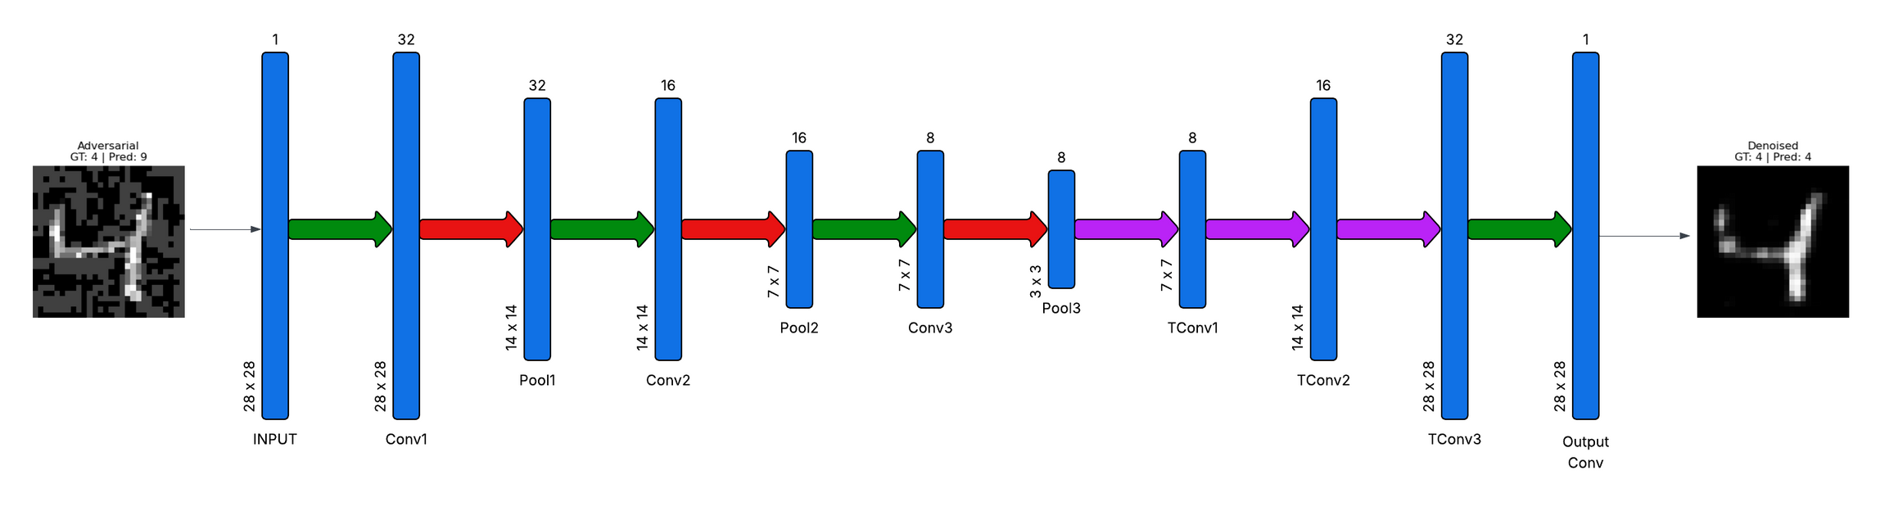
DENOISING AUTOENCODER ARCHITECTURE
CONV2D + RELU
MAXPOOL2D(2X2)
CONVTRANSPOSE2D + RELU

Slide 23
DENOISING AUTOENCODER ARCHITECTURE
The ConvDenoiser is a convolutional autoencoder that learns to reconstruct clean images from noisy or adversarial inputs.
This was our base model we used it to get an idea of how denoising works.
First the images were upsampled and then downsampled using a CNN architecture.

Slide 24
USING PIXEL-LOSS : MNIST
Attack | Clean accuracy | Adversarial accuracy | Denoised accuracy
FGSM | 0.9950 | 0.1959 | 0.8858
PGD | 0.9950 | 0.0079 | 0.8411
BIM | 0.9950 | 0.0005 | 0.8006

Slide 25
USING FEATURE-LOSS IN DENIOSER ARCHITECTURE: MNIST
Attack | Clean accuracy | Adversarial accuracy | Denoised accuracy
FGSM | 0.9950 | 0.1959 | 0.8394
PGD | 0.9950 | 0.0079 | 0.9116
BIM-A | 0.9950 | 0.0005 | 0.8705
BIM-B | 0.9950 | 0.0004 | 0.9087

Slide 26
USING FEATURE-LOSS IN DENOISER ARCHITECTURE : CIFAR10
Attack | Clean Accuracy | Adversarial Accuracy | Denoised Accuracy
FGSM | 0.8036 | 0.0338 | 0.2733
PGD | 0.8036 | 0.0001 | 0.2514
BIM-A | 0.8036 | 0.0001 | 0.2702
BIM-B | 0.8036 | 0.0001 | 0.2217

Slide 27
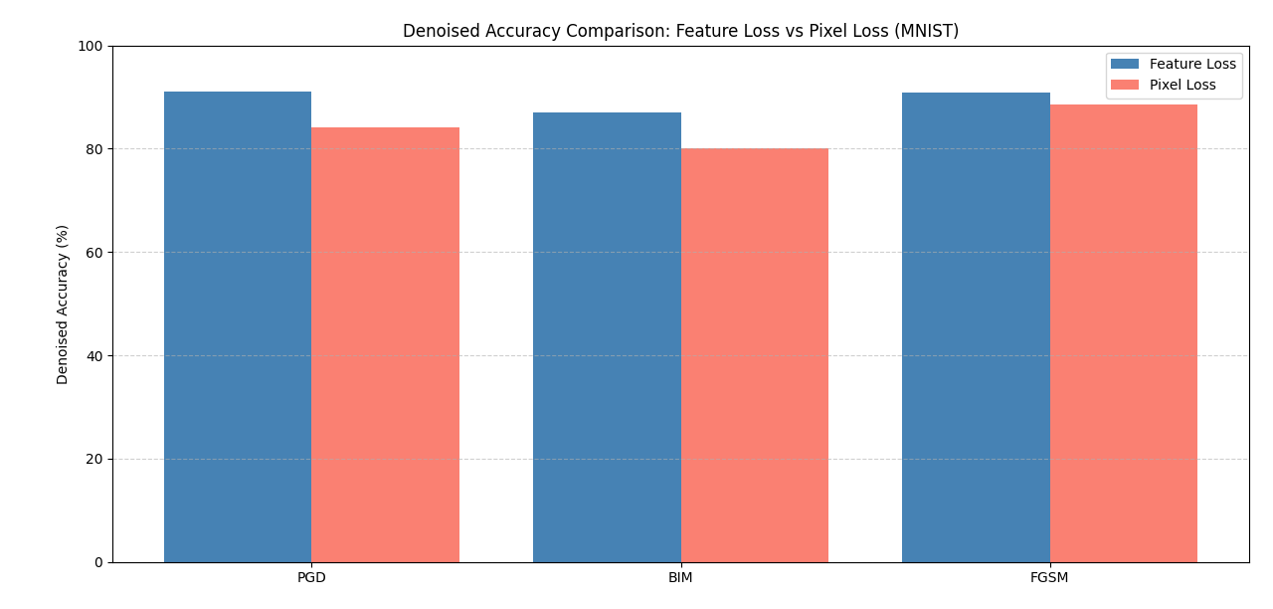
COMPARISION :
FEATURE LOSS VS PIXEL LOSS

Slide 28
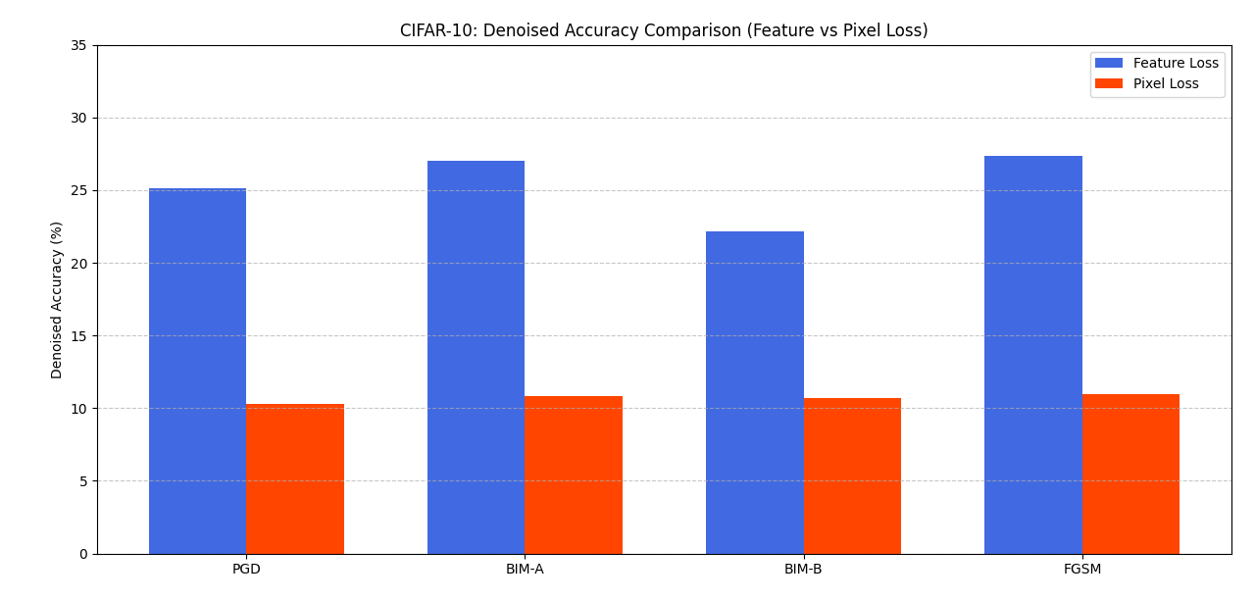
COMPARISION :
FEATURE LOSS VS PIXEL LOSS

Slide 29
OBSERVATIONS
Cifar-10 is a relatively complex dataset and Pixel-loss alone cannot capture the complex relations
To mitigate this issue, we experimented with feature-level loss in which the loss is not pixel level, but instead it is high-level feature based

Slide 30
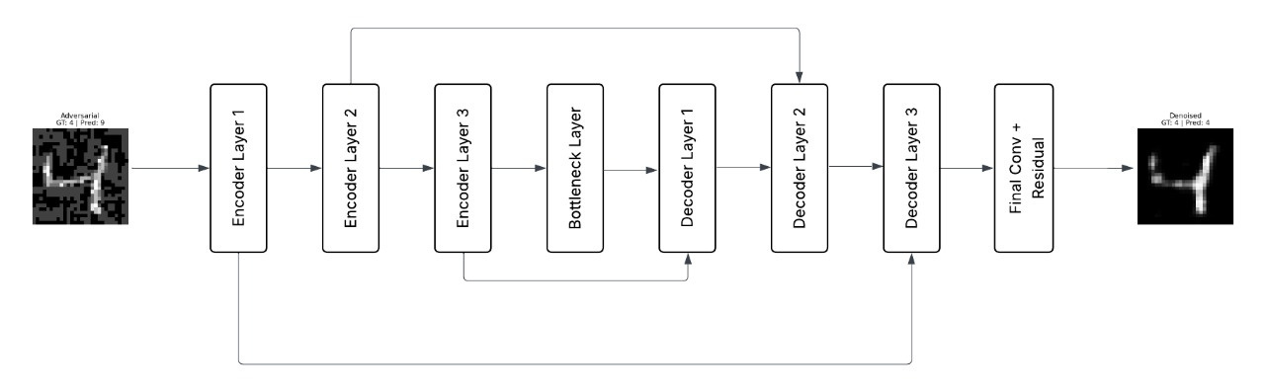
HIGH - LEVEL GUIDED DENOISER ARCHITECHTURE

Slide 31
USING HIGH LEVEL GUIDED DENOISER WITH FEATURE-LOSS : MNIST
Attack | Clean Accuracy | Adversarial Accuracy | Denoised Accuracy
FGSM | 0.9864 | 0.0338 | 0.9853
PGD | 0.9864 | 0.0001 | 0.9819
BIM-A | 0.9864 | 0.0001 | 0.9852
BIM-B | 0.9864 | 0.0001 | 0.9803

Slide 32
USING HIGH LEVEL GUIDED DENOISER WITH FEATURE-LOSS : CIFAR10
Attack | Clean Accuracy | Adversarial Accuracy | Denoised Accuracy
FGSM | 0.8036 | 0.0338 | 0.7596
PGD | 0.8036 | 0.0001 | 0.7552
BIM-A | 0.8036 | 0.0001 | 0.7671
BIM-B | 0.8036 | 0.0001 | 0.7370

Slide 33
HIGH LEVEL GUIDED DENOISER USING PIXEL-LOSS : CIFAR10
Attack | Clean Accuracy | Adversarial Accuracy | Denoised Accuracy
FGSM | 0.8036 | 0.0338 | 0.1094
PGD | 0.8036 | 0.0001 | 0.1029
BIM-A | 0.8036 | 0.0001 | 0.1081
BIM-B | 0.8036 | 0.0001 | 0.1067

Slide 34
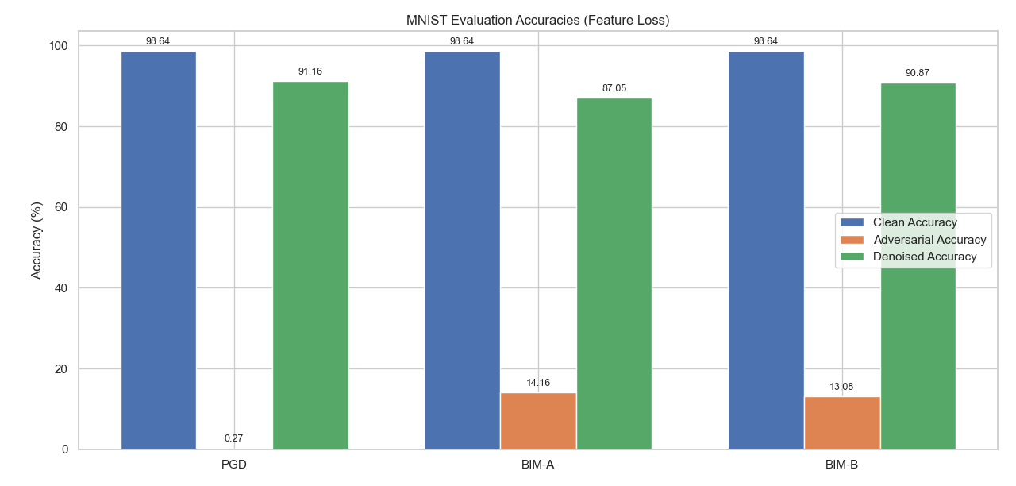
USING FEATURE LOSS WITH DENOISER ARCHITECTURE : MNIST

Slide 35
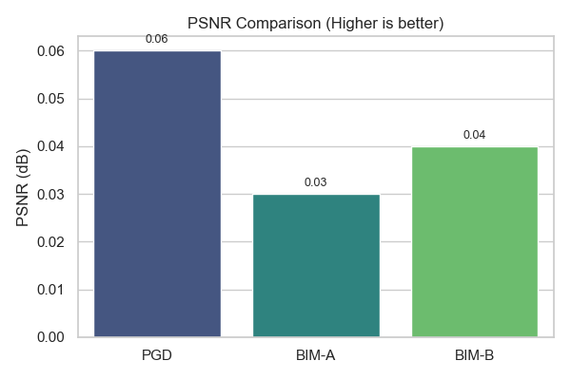
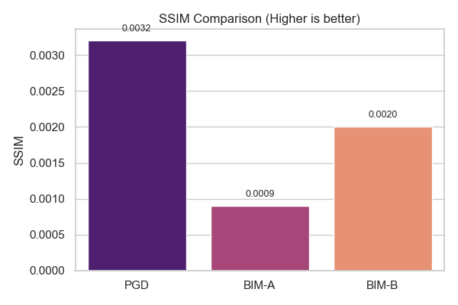
RESULTS ON MNIST

Slide 36
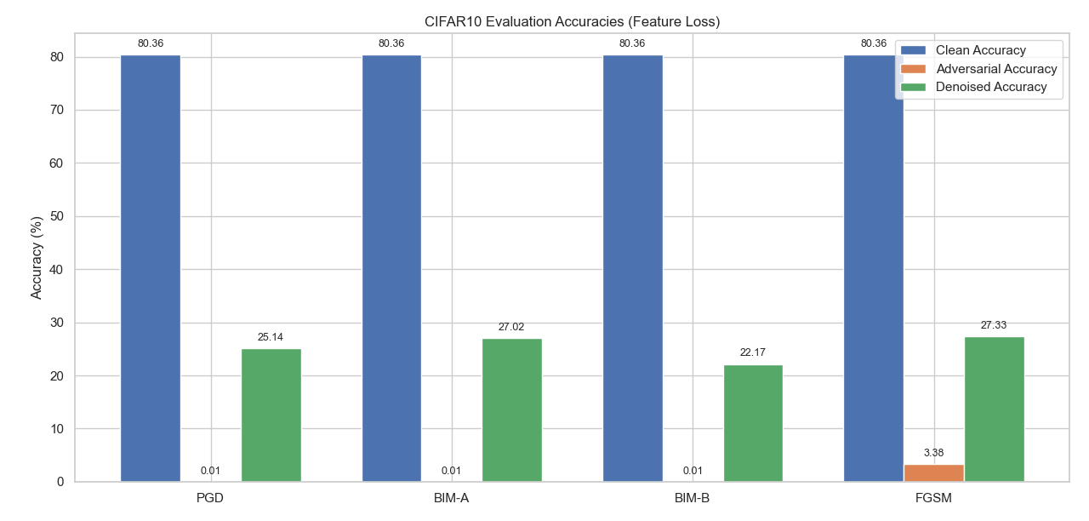
USING FEATURE LOSS WITH DENOISER ARCHITECTURE : CIFAR10

Slide 37
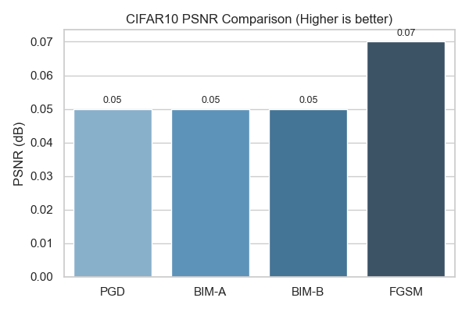
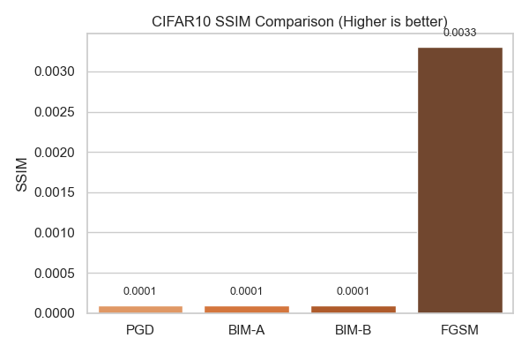
RESULTS ON CIFAR-10

Slide 38
DENOISER TRAINING BEHAVIOR
During training, the High-Level Representation Guided Denoiser (HGD) shows rapid gains in validation accuracy within the first 10–15 epochs, as it quickly learns to suppress dominant adversarial patterns. However, after around 15–20 epochs, validation accuracy begins to fluctuate despite continued decreases in training loss, indicating the onset of overfitting. This suggests that the model starts to memorize training-specific perturbations rather than generalizing to unseen ones.

Slide 39
EVALUATING OTHER PURIFICATION METHODS ON CIFAR-10
Classifier Used | Denoiser Used | Dataset | Attack | Loss Used | Accuracy Obtained (Clean Images) | Accuracy Obtained (Denoised Images)
RestNet-32 | Denoiser Autoencoder (CNN architechture) | CIFAR-10 | FGSM | Pixel Level Loss | 84.87% | 16.48%
ResNet-32 | Denoiser Autoencoder (CNN architechture) | CIFAR-10 | FGSM | Pixel Level + High Level Feature Loss | 84.87% | 41.25%
ResNet-32 | High-Level Guided Denoiser | CIFAR-10 | FGSM+PGD+C&W+BIM | High Level Feature Loss | 84.47% | 64.37%

Slide 40
CONCLUSION
Unified Defense Pipeline: Most existing research focuses on either detection or purification. Our work integrates both, making it a more complete and deployable adversarial defense system.
Single DAE, Multi-Attack Purification: Unlike prior methods that train separate models for different attacks, we show that one denoising autoencoder can effectively purify samples from diverse attacks (FGSM, PGD, BIM), simplifying the architecture
Robust Generalization: Our DAE is trained to handle noise patterns from multiple adversaries, enabling it to generalize purification across attack types — a feature rarely addressed in earlier works.
Significant Accuracy Recovery: We demonstrate a drastic improvement in classification accuracy post-denoising (e.g., from 0.07% to 82.56% on PGD), validating the strength of our purification module.

Slide 41
Contributions
K Rithwin | Generating adversarial exmaples, Classifier for MNIST dataet, Worked on detector(base) and detector(dual manifold), purifier(DAE) modifications, whole project integration, PPT | 18
Ritesh Baviskar | Worked on developing the diffusion model for experimentation. Generation of adversarial samples on various datasets. Integration of detector with purifier. Conducting ablation studies. Improving detector accuracy, PPT | 18
Aaditi Agrawal | Generated adverserial examples, made ResNet-32 classifier, Conducted experiments on purifier architectures, Added Perceptual (High-Level Feature Loss) to the denoiser autoencoder to purify CIFAR-10 dataset) and improved its accuracy. Experimented with high-level-guided denoiser and added pixel loss to it, PPT | 18
Ayush Meena | Developed denoising autoencoder to purify adversarial MNIST examples generated using FGSM, PGD, and BIM attacks. | 18
Piyush Patil | Worked on KDE-based adversarial detection. Generating Adversarial Examples. | 18
Aditya Jagdale | Investigated and evaluated detection technique like Feature squeezing on adversarial attacks on cifar-10 dataset, PPT | 10

Slide 42
Thank You

